Slide 1

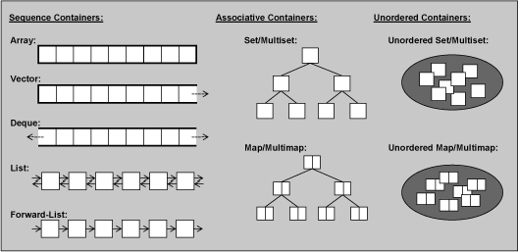
CPSC 131 – Data Structures
Binary Tree Abstract Data Types
Professor T. L. Bettens
Fall 2020

Slide 2
Problem: How to Create a Dictionary?
I need a data structure that holds definitions of terms, but I only have the name of the term. How can I find its definition efficiently?
If instead of a name I had a number, I could use an array
definition = dictionary[7];
I want that capability but using a string not a number. Can C++ do that?
definition = dictionary["apple"];

Slide 3
Concepts & Interface
Jusuttis, The C++ Standard Library
6.2.2. Associative Containers
6.2.4. Associative Arrays
CPPReference.com
Containers library
std::set
std::multiset
std::map
std::multimap
zyBook
Associative Containers: Trees
Chapter 6
Associative Containers: AVL Balanced Trees
Chapter 7

Slide 4
Associative Containers
Associative containers sort their elements automatically according to a certain ordering criterion
Elements are either
values of any type (std::set, std::multi_set)
key/value pairs (map, std::multi_map)
Each key maps to an associated value
The criterion to sort the elements
A function that compares either the value (sets) or the key (maps)
By default, operator < is used
You can supply your own comparison function
Implemented as balanced binary trees
Every element (node) has one parent and up to two children
All ancestors to the left have lesser values
All ancestors to the right have greater values
The associative containers differ in
The kinds of elements they support (value, key/value)
How they handle duplicates
Major advantage of associative containers
Finding an element with a specific value is rather fast because it has logarithmic complexity
Remember, in all sequence containers, you have linear complexity
Drawback
You can’t modify values (sets) or keys (maps) directly
Would corrupt the automatic sorting of the elements
Predefined in the STL:
std::set | A collection in which elements are sorted according to their own values. Duplicates are not allowed
std::multiset | Same as a set except that duplicates are allowed
std::map | Contains elements that are key/value pairs. Each element has a key that is the basis for the sorting criterion and a value. Duplicate keys are not allowed
std::multimap | Same as a map except that duplicates are allowed

Slide 5
Associative Arrays
An array whose index is not an integer value
Elements access with subscript operator [].
Collections of key/value pairs with unique keys
std::maps and std::unordered_map
Specify both the type of the key and the type of the value
map<string, double> coll; // keys are strings and the associated values are floating-point values
Access elements by using the subscript operator []
Subscript operator does not behave like the usual subscript operator for arrays
Not having an element for an index is not an error
A new index (or key) is taken as a reason to create and insert a element that has the index as the key.
You can’t have an invalid index.
Alternatively, use at() to access values of elements while passing the key. In this case, a key not found results in an out_of_range exception:
As usual, the difference between using an unordered map and a map is that
Elements in an unordered map
Have arbitrary order
Complexity for element access is amortized constant O(1)
Elements in a map
Are sorted
Complexity for element access is logarithmic O(log n)
O(1) vs O(log n): Prefer unordered maps over maps
Unless you need the elements to be sorted
We’ll talk more about unordered maps, aka hash tables, in the next chapter

Slide 6
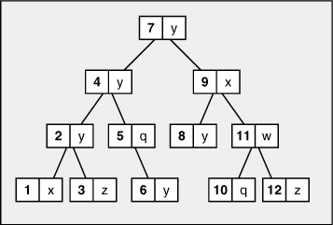
Abilities of Maps and Multimaps
Maps and multimaps sort their elements automatically
Have good performance,O(log n), when searching for elements that have a certain key.
Automatic sorting imposes an important constraint:
The element’s key is constant. You may not change the key of an element directly, because doing so might compromise the correct order.
To modify the key of an element, you must remove the element that has the old key and insert a new element that has the new key and the old value
The element’s value is not constant and can be modified

Slide 7
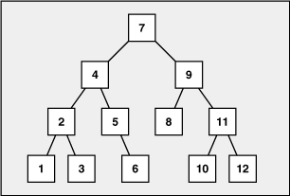
Tree Abstract Data Type
Sets
Maps
Node based structure containing values
Each node contains a left, right and parent
Sorted such that
Nodes to the left are less
Nodes to the right are greater
Node based structure containing key/value pairs
Each node contains a left, right and parent
Sorted such that
Nodes to the left are less
Nodes to the right are greater

Slide 8
BST Implementation Example
Interface
(header files)
Implementation
(source files)
both iterative and
recursive solutions

Slide 9
Analysis of the Binary Tree Abstract Data Type Complexity Analysis (1)
Function | Analysis – std::map<K, V> (binary tree, no duplicates) | Analysis – std::multimap<K, V> (binary tree, yes duplicates)
at() operator[] | O(log₂ n) | same
size() | O(n) std::forward_list<T> calculates size on demand O(1) if size maintained, as in zyBook | same
empty() | O(1) | same
clear() | O(n) All elements are destroyed and size set to zero | same

Slide 10
Analysis of the Vector Abstract Data Type Complexity Analysis (2)
Function | Analysis – std::forward_list<T> (Singly Linked List) | Analysis – std::list<T> (Doubly Linked List)
push_back() | Not available | same
erase() | O(log₂ n) if you don’t have erasure point O(1) if you have erasure point | same
count/contains returns the number of elements matching specific key | O(log₂ n) | same

Slide 11
Analysis of the Vector Abstract Data Type Complexity Analysis (3)
Function | Analysis – std::forward_list<T> (Singly Linked List) | Analysis – std::list<T> (Doubly Linked List)
insert() | O(log₂ n) if you don’t have insertion point O(1) if you have insertion point | same
default construction | O(1) creates an empty container | same
Equality C₁ == C₂ | O(n) | same

Slide 12
Analysis of the Vector Abstract Data Type Complexity Analysis (4)
Function | Analysis – std::forward_list<T> (Singly Linked List) | Analysis – std::list<T> (Doubly Linked List)
push_front | Not available | same
equal_range Returns a range containing all elements with the given key in the container. | O(log₂ n) | same
find | O(log₂ n) binary search from root to leaf | same

Slide 13
Analysis of the Vector Abstract Data Type Complexity Analysis (5)
Function | Analysis – std::forward_list<T> (Singly Linked List) | Analysis – std::list<T> (Doubly Linked List)
visit() e.g. print() | O(n) Visiting every node from begin() to end() | same
visit_reverse() e.g. print_reverse() | O(n) Visiting every node from rbegin() to rend() Direction doesn’t matter | same
merge() | N * O(log₂ n), where N is the size of the other tree and n is the size of this tree. Basically, repeat insert() N time | same

